Slide 1
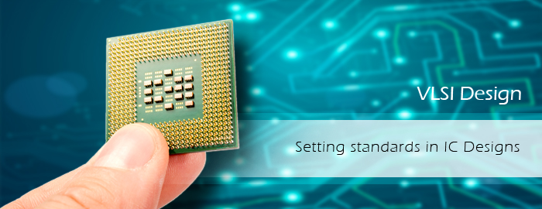
DESIGN OF NOVEL TERNERY TO BINARY

Slide 2


PRESENTED BY:
ABHINANDAN SHARMA
ABHINAV KUMAR
ARINJOY PODDAR
MRINAL BHARDWAJ
SHASHWAT KUMAR
SHUBHAM KUMAR SINHA
Under the guidance of :
Dr. Aloke Saha
Department of Electronics & Communication Engineering

Slide 3

CONTENT
Introduction
Motivation
Literature Review
Purpose to work
Road map of next work
Conclusion
References

Slide 4

INTRODUCTION
The Ternary number system (also called base 3) has three as its base. Analogous to bit, a ternary digit is a Trit.
1 trit = log23 = 1.585 bit
1 tryte = 6 trits = 9.5 bits
As in binary there are only 0 and 1 in recognition, Ternary have 0,1 and 2.
In Ternary, there are two voltage levels and one ground.
For 0, Voltage = 0 V (grounded)
For 1, Voltage = 0.9 V
For 2, Voltage = 1.8 V
Base 3 is more efficient in terms of the actual number of characters needed to express any given number on average.

Slide 5

MOTIVATION
To decrease the complexity of the Circuit
The fabrication cost will be less
There is less chances of IC getting damaged
Power consumption will be less
Less number of bits will be required to store large data.

Slide 6
LITERATURE REVIEW
In 1960, The first ternary computer, SETUN & SETUN 70 was developed in Moscow state university in Russia.
In 1964, Alexander shows the natural base (e=2.71828) is the most efficient radix for implementation of switching circuit and it seems that the most efficient radix for implementation of digital system is 3 than 2.
In 1965, Eichelberger proposed the use of ternary simulation for the analysis of races in asynchronous sequential networks.
In USA, the ternary computing emulator Ternac working on a binary machine was developed in 1973.
The Conjoiners, in Alastair Reynolds' Revelation Space series, use ternary logic to program their computers and nanotechnology devices.

Slide 7
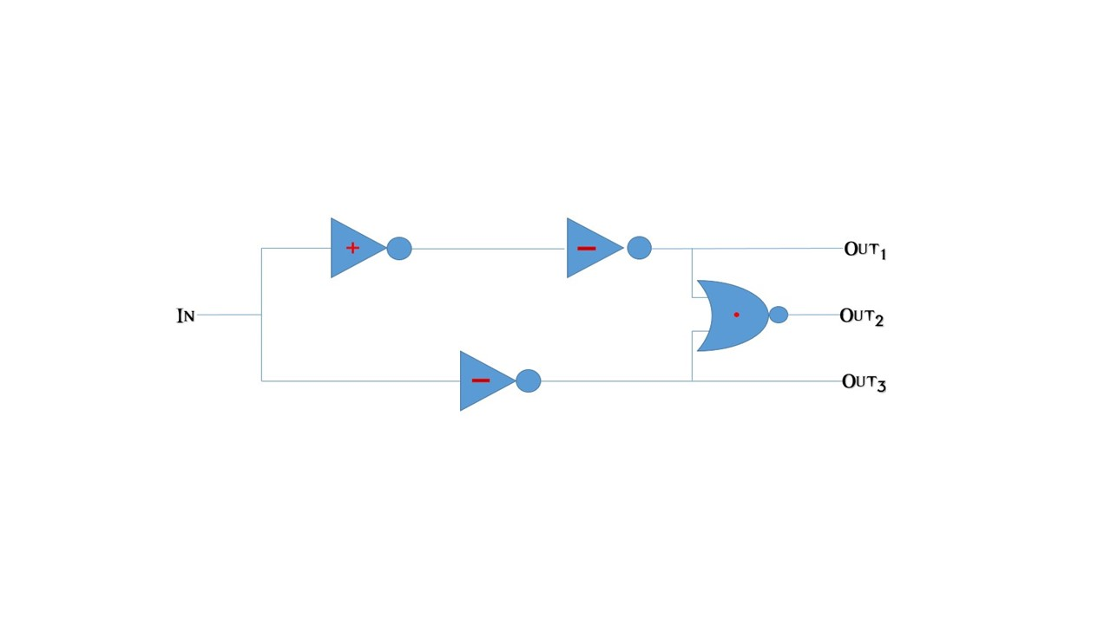

Slide 8

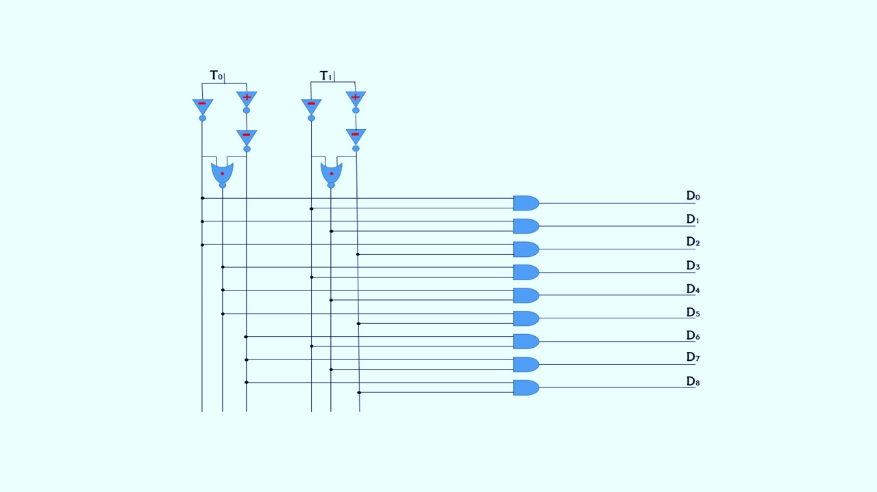

Slide 9
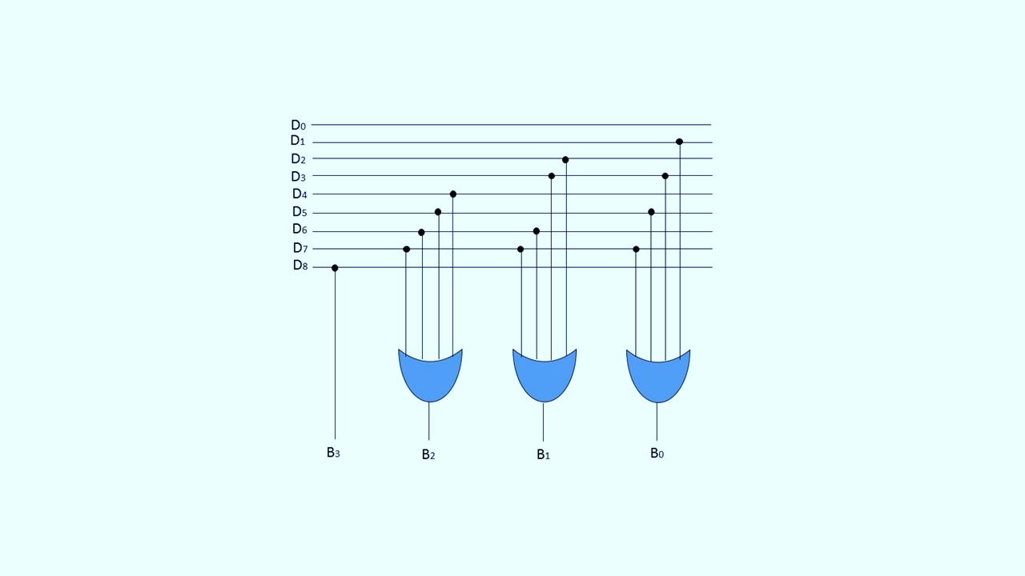

Slide 10
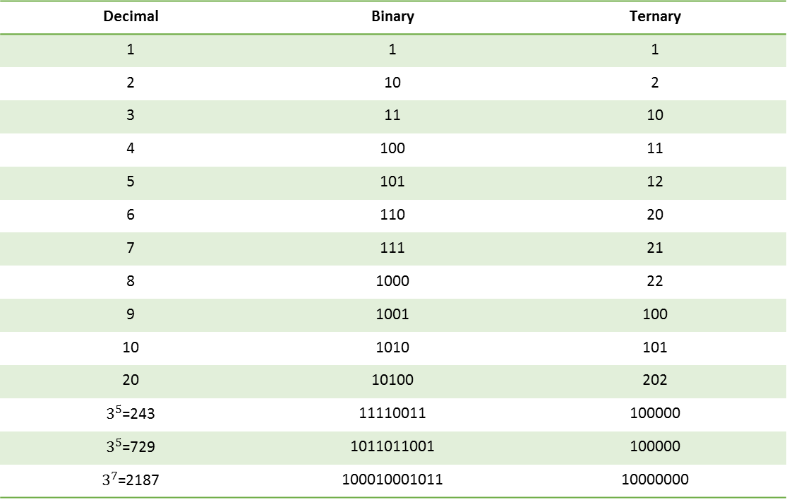
ADVANTAGES
Higher density of information per bit can lead to more compact data representation.
It has particular advantages in DSP application (Convolution, FFT).
Decimal | Binary | Ternary
1 | 1 | 1
2 | 10 | 2
3 | 11 | 10
4 | 100 | 11
5 | 101 | 12
6 | 110 | 20
7 | 111 | 21
8 | 1000 | 22
9 | 1001 | 100
10 | 1010 | 101
20 | 10100 | 202
$3^{5}$=243 | 11110011 | 100000
$3^{5}$=729 | 1011011001 | 100000
$3^{7}$=2187 | 100010001011 | 10000000

Slide 11
ROAD MAP TO THE NEXT WORK
Step- 1:
Designing of circuit using Tanner S Edit Application Software.
Step- 2:
Circuit Analysis will be done. Observation will be taken from the input-output characteristic curve to find out the Rise Time, Fall Time and delay in the circuit.
Step- 3:
Implementation of the circuit for some major operation
Designing of circuit
Circuit Analysis
Implementation of circuit

Slide 12
WHAT MODIFICATIONS THIS CIRCUIT HAVE..?
Earlier Ternary circuits uses active and passive components but this one is only based on passive components (CMOS).
Using this circuit is advantageous as threshold voltage of the CMOS is kept fixed.
Circuit based on the concept of ternary logic was hard to implement as the systems are based on binary logic hence this ternary to binary converter will be helpful.

Slide 13
D0
D1
D2
D3
D4
D5
D6
D7
D8
B3
B2
B1
B0

Slide 14
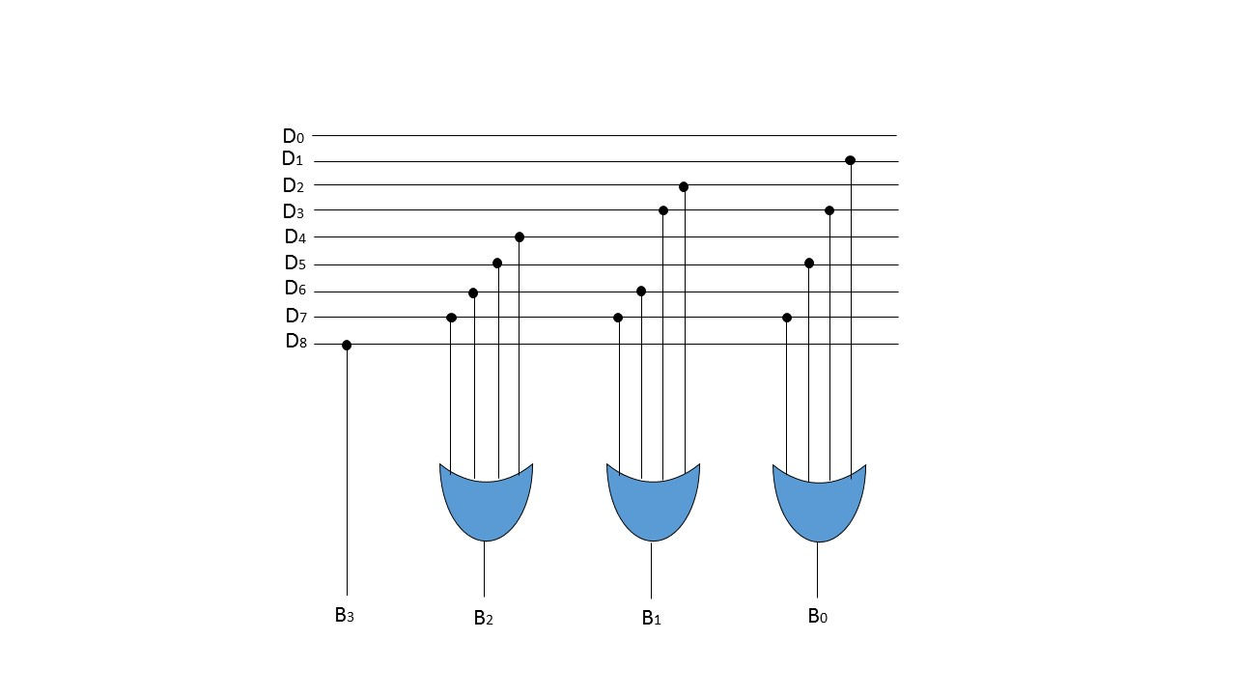

Slide 15

